Slide 2
Web Programming
Phil Duncan
plduncanjr@gmail.com
January 11 & 18, 2019
7:30 am – 4:30 pm

Slide 3
Web Programming
Overview
Brief History and Evolution
Development Platforms
Understanding MVC
Building Simple Applications

Slide 4
Web Programming
The Web
Information Superhighway
Web 2.0

Slide 5
Web Programming
Web 2.0
Single Page Applications
The Responsive Web
Mobile First

Slide 6
Environment
Front End Development
HTML
Javascript
Back End – Various CGI
CSS

Slide 7
Environment
Front End Development
XML
AJAX
Asynchronous Javascript and XML

Slide 8
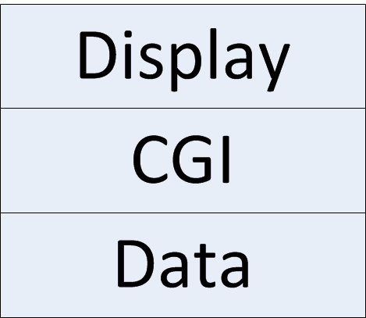
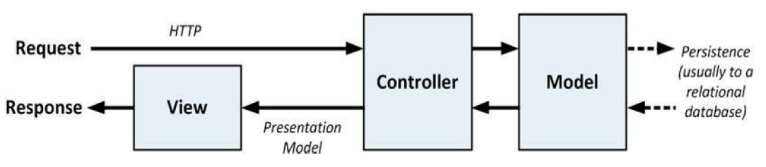
Environment
Three Tier Architecture
MVC Architecture

Slide 9
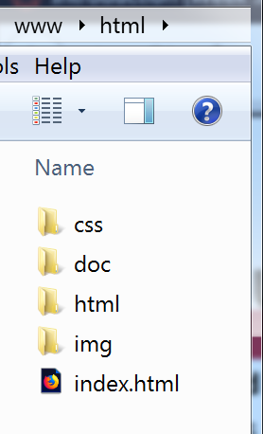
Environment
Previous Web Root
Link Types:
Relative
Absolute
Absolute Relative

Slide 10
Scaffolding
A framework using specified pre-defined code templates to generate the final code the application uses to create, read, update and delete database entries.
Templates are used as a "scaffold" on which applications are built.
Why Scaffold?

Slide 11
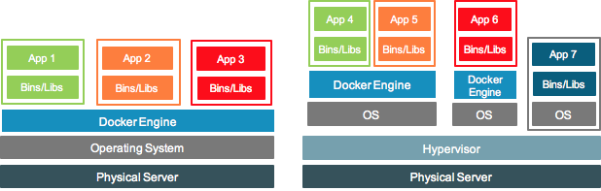
Scaffolding
Containerization Virtualization
Dependency Injection

Slide 12
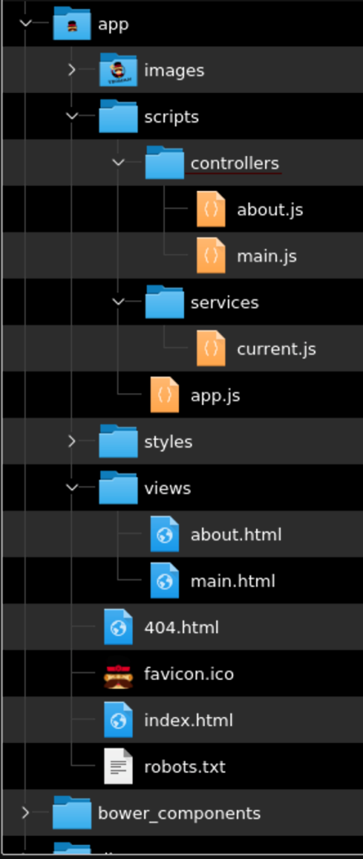
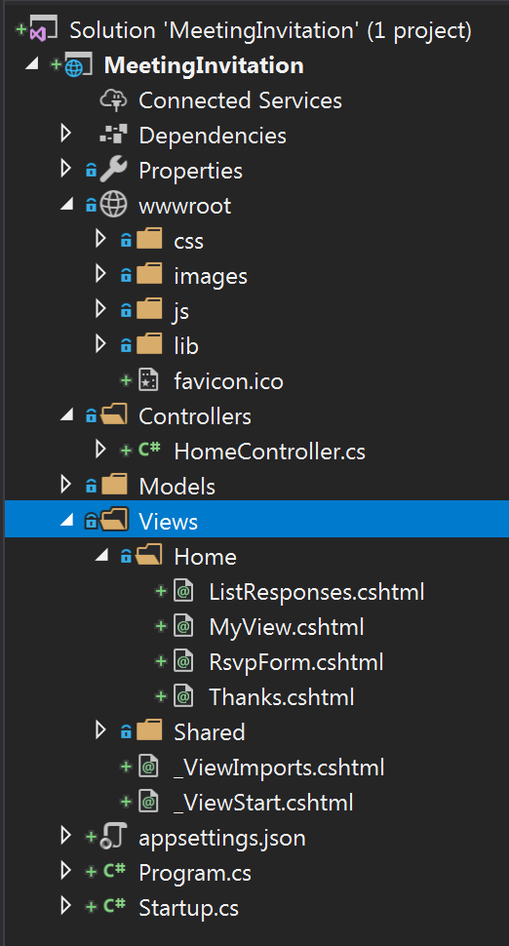
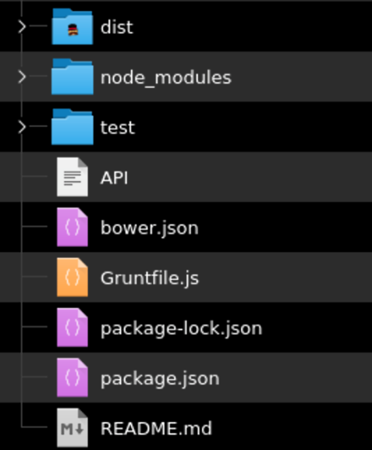
Scaffolding
Visual Studio Yeoman

Slide 13
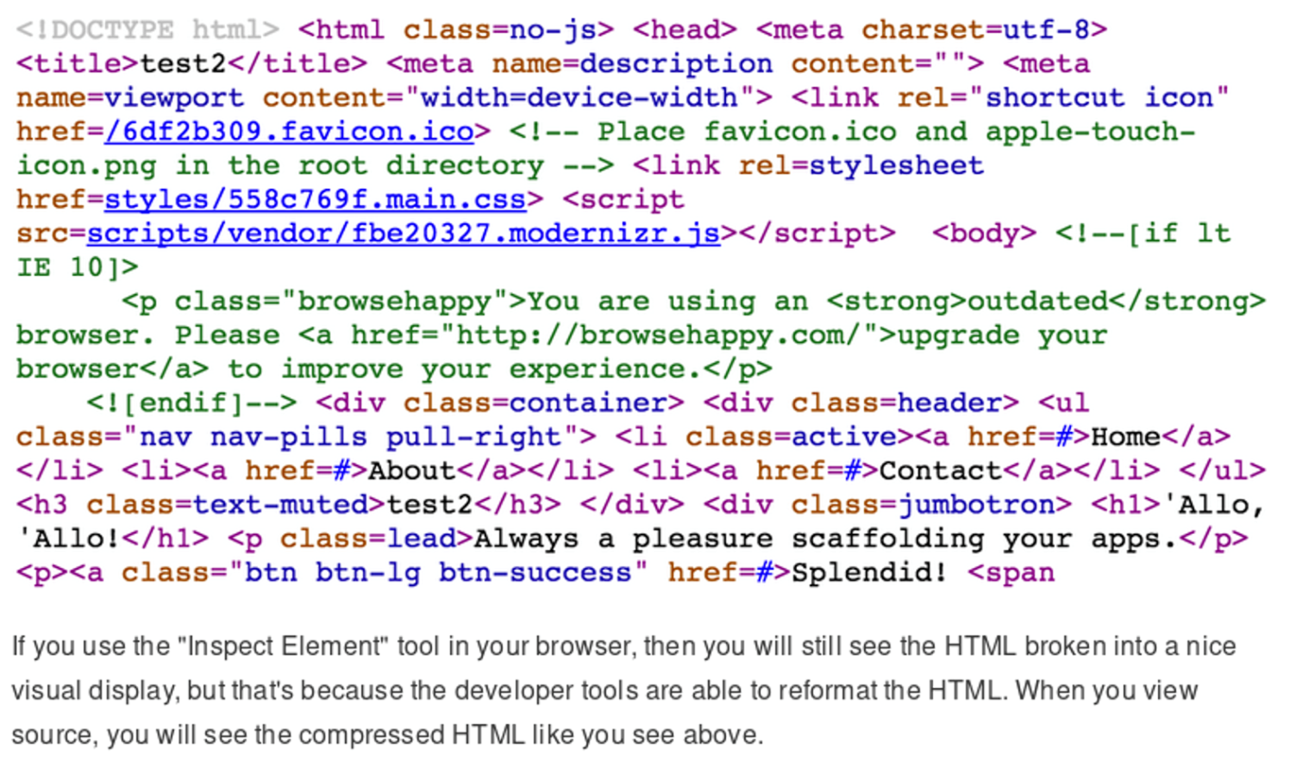
Scaffolding
Minified Code

Slide 14
MVC
Models
Views
Controllers
Routers

Slide 15
Scaffolding
Visual Studio Yeoman

Slide 16
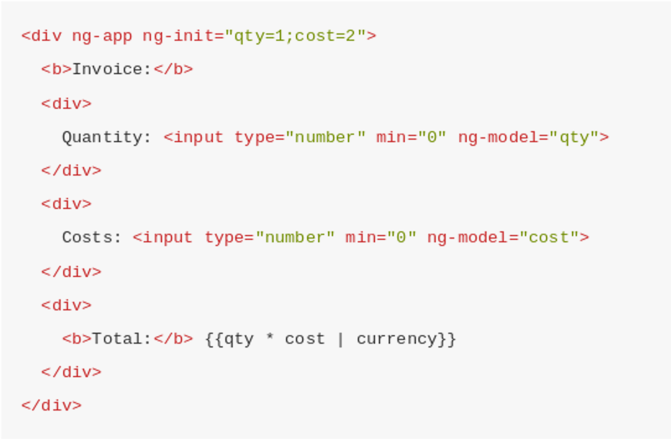
Angular JS
Data Model
ASP.NET uses Tag Helpers

Slide 17
Meet the Stack
Node.js V8 ECMAScript
Web Assembly
Angular
MVC Tools
Express
React
Pug

Slide 18
MVC Tools
Npm – Node Package Manager
Yeoman
Bower
Gulp / Grunt
GitHub

Slide 19
Containerization
Services spin up on demand within virtual federations.
Azure, AWS, Google, Inhouse Cloud, Digital Oceans Droplets
Docker & Kubernetes
Dependency Injection

Slide 20
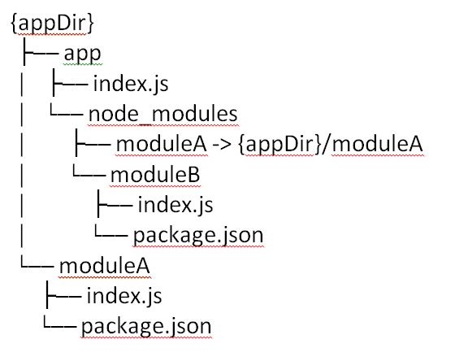
Containerization
Dependency Injection
Configuration Management on the fly
The --preserve-- symlinks command line flag instructs Node.js to use the symlink path for modules as opposed to the real path, allowing symbolically linked peer dependencies to be found.

Slide 21
Environment
Previous Web Root
Link Types:
Relative
Absolute
Absolute Relative

Slide 22
Environment
Previous Web Root
Link Types:
Relative
Absolute
Absolute Relative

Slide 23
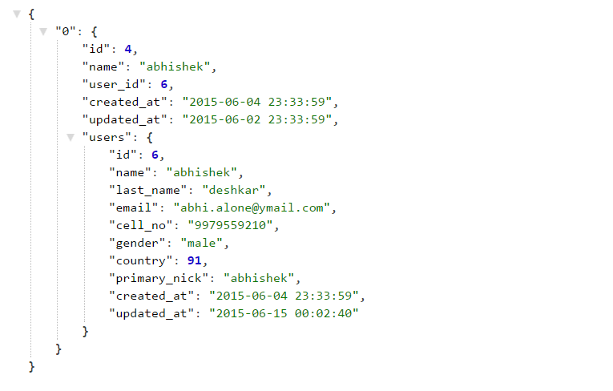
Data Model Structure
JSON – JavaScript Object Notation
Comma delineated list of name value pairs:
HTTP Payload
{
“Object”: {
“name” : “value”,
“name” : “value
}
}

Slide 24
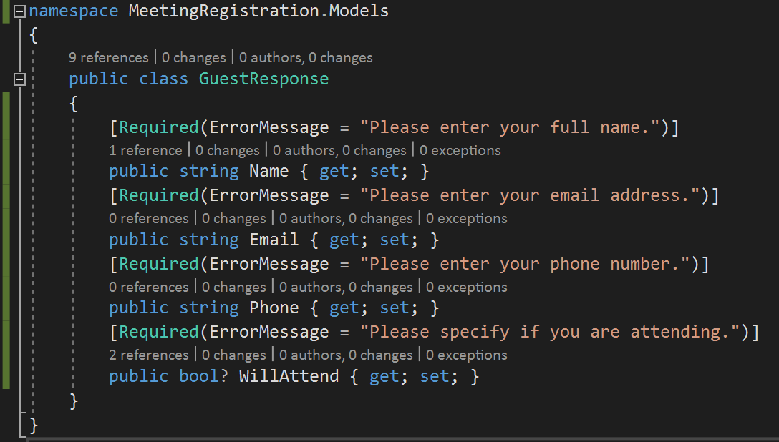
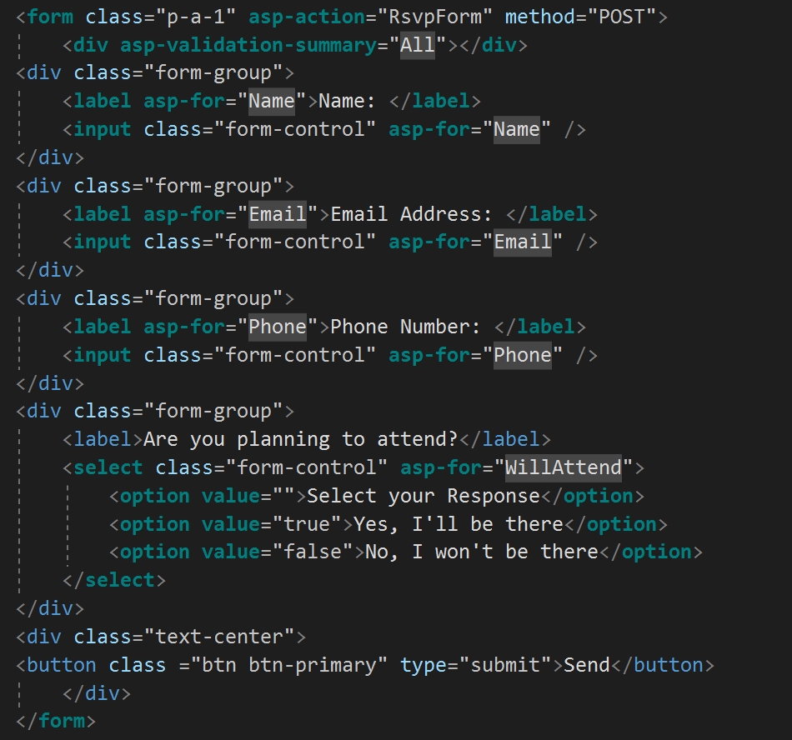
Data Model Structure
ASP.NET Razor Data Model Format
Data Model Repository
User Form

Slide 25
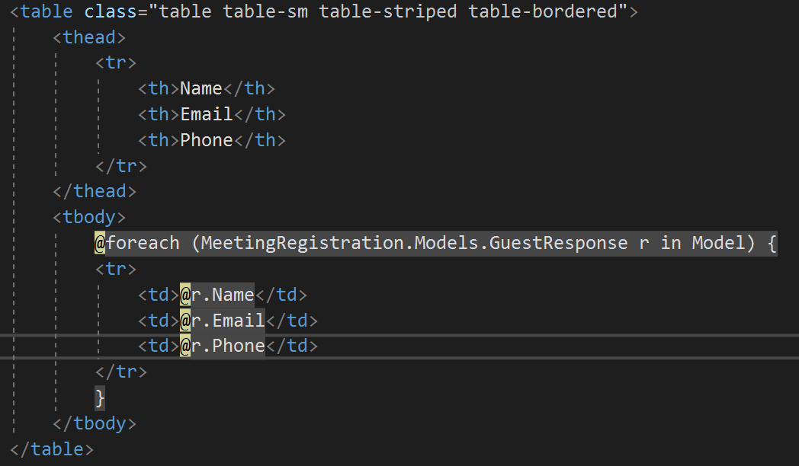
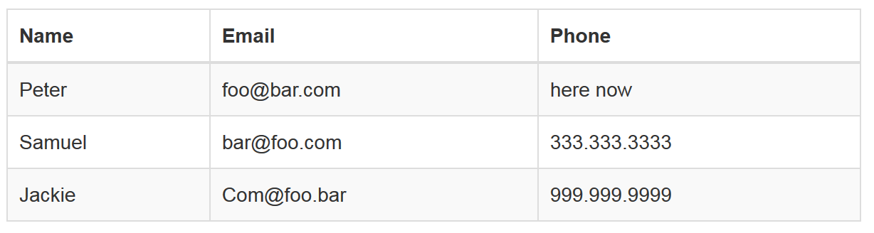
Data Model Structure
ASP.NET Razor Data Model Format
View Markup
Rendered View

